Slide 1
SAJHA BAZAR
Team members
Arjun Chettri[THA075BEI07]
Shovit Nepal[THA075BEI040]
Suraj Agrahari[THA075BEI043]
Sushovan Shakya[THA075BEI046]
Supervisor
Er. Rama Bastola
Department of Electronics and Computer Engineering
Institute of Engineering, Thapathali Campus
August 9, 2019

Slide 2
Presentation outlines
Motivation
Objectives
Introduction
Methodology
Demo with sample data
Conclusion and Further works
References

Slide 3
Motivation
Will to make something different.
Market Management.
Contribution to society.
Shopping with fun.
Systematic management in small scale.

Slide 4
Objective
To contribute in the digital society.
To provide all the goods related services in one system.
To maintain well managed marketing system.
To make shopping process easier and faster.
To maintain healthy relationship with the customer.

Slide 5
Introduction
Background and central idea of project.
Problem faced
Project feature
Feasibility analysis
System requirement
Software requirement
Hardware requirement

Slide 6
Methodology
Home screen .
Customer ID.
Admin.
User.

Slide 7
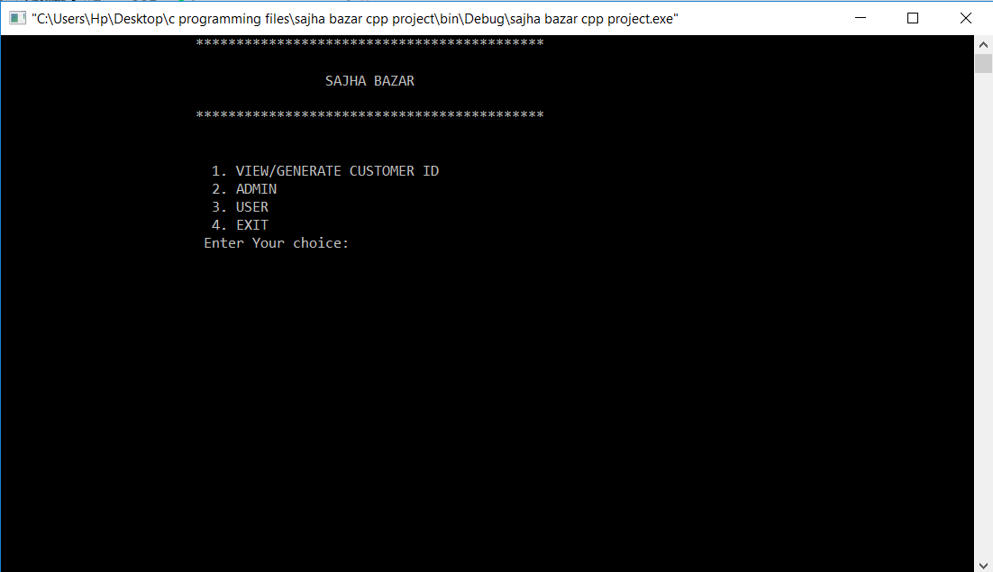
Home screen
Output
one can select different desired task to perform
Home screen
Customer ID
User
admin

Slide 8
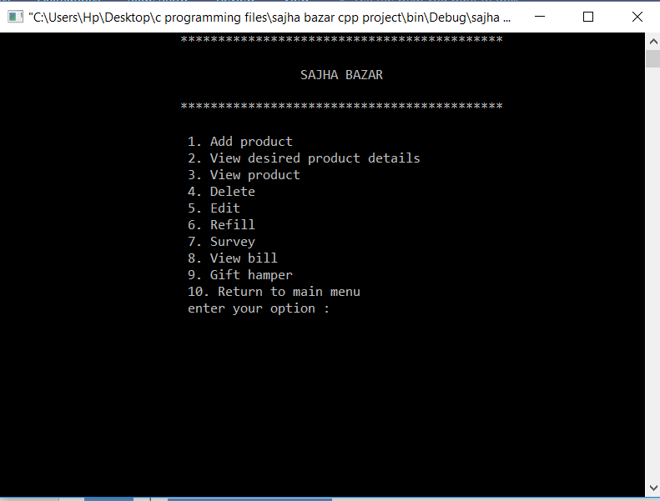
Admin
Need password to access
Admin
Add product
View product
View all product
Delete
Edit
Refill
Survey
Gift hamper
Output

Slide 9
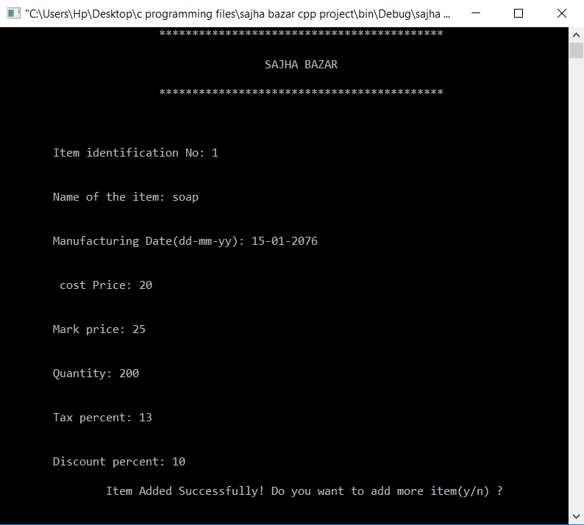
Add
One can add desired goods
Item ID
Manufacture date
Cost price
Mark price
Quantity
Name of item
Tax percent
Discount percent’

Slide 10
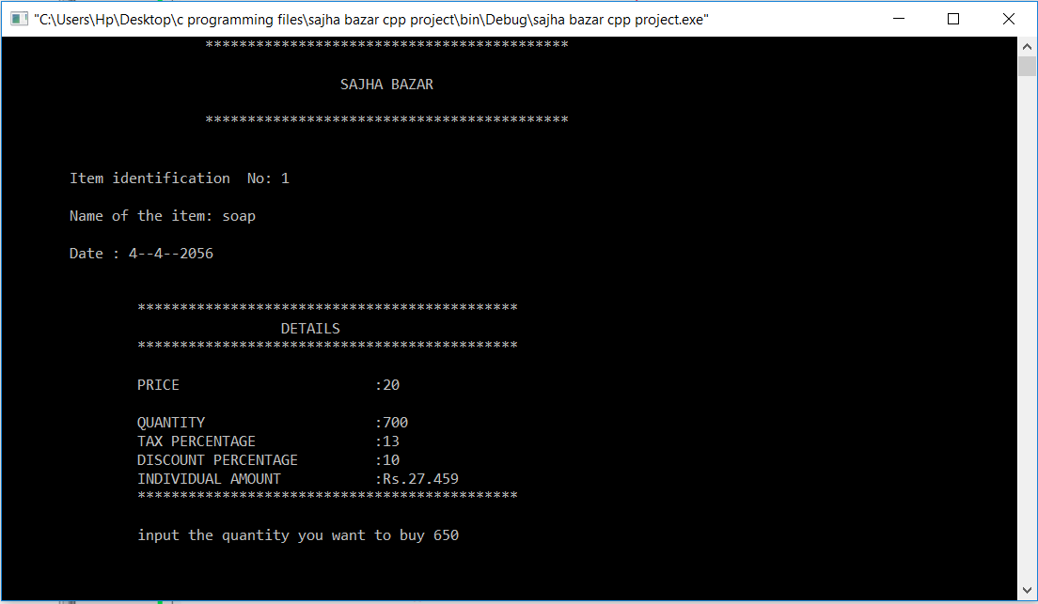
View product
To show individual bill
Output

Slide 11
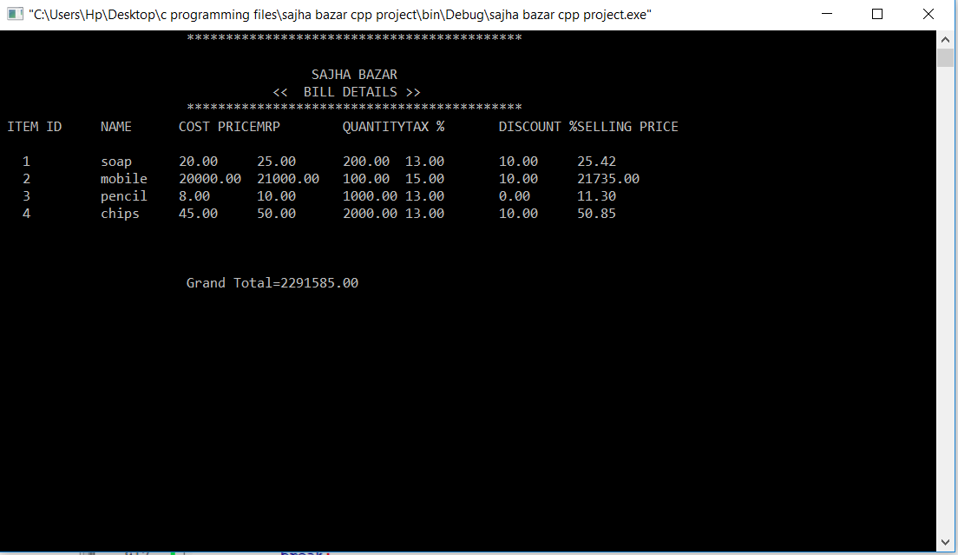
View all product
One can view all product

Slide 12
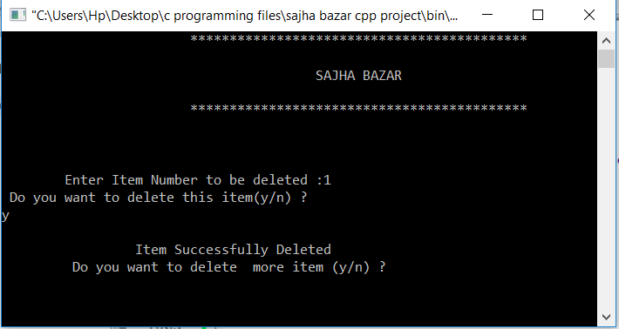
Delete
One can delete undesired product
Output
Main file
User enter data
Temporary file
All except entered data from is copied to tempoaray file
Main file
Temp file conatin is copied to new main file
Main file is deleted
Temp file is deletd

Slide 13
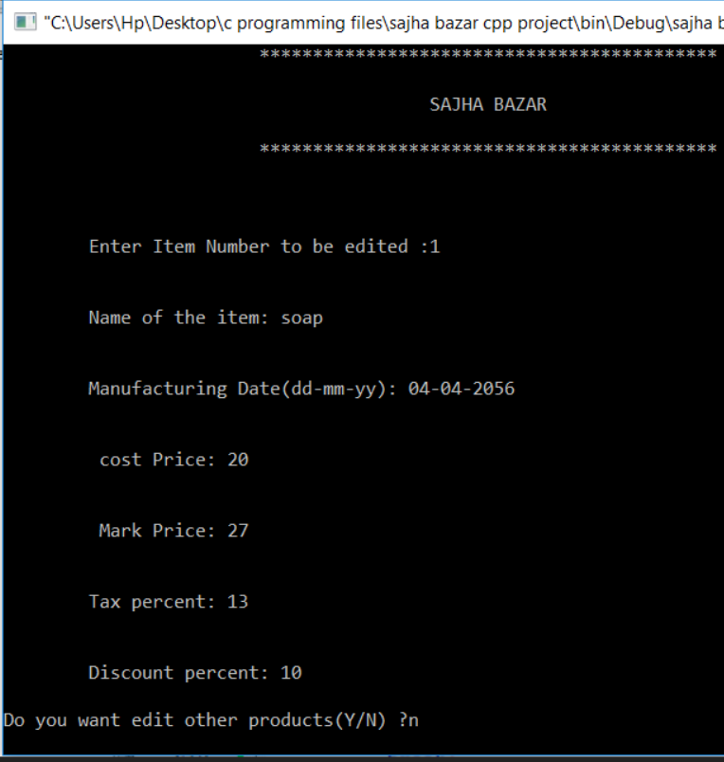
Edit
Output
Data is overwrite to edit desired product .

Slide 14
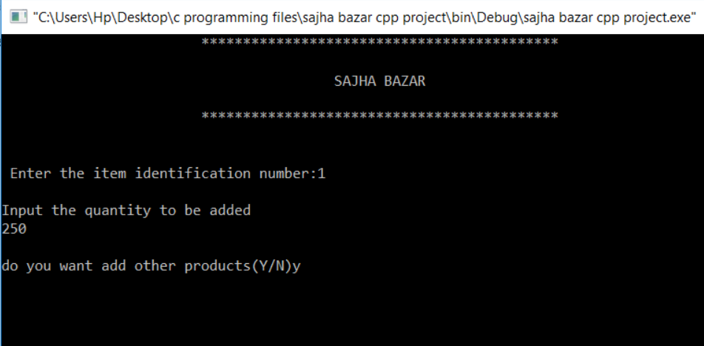
Refill
One can add desired quantity
Initial quantity
Added quantity
Total quantity
Output

Slide 15
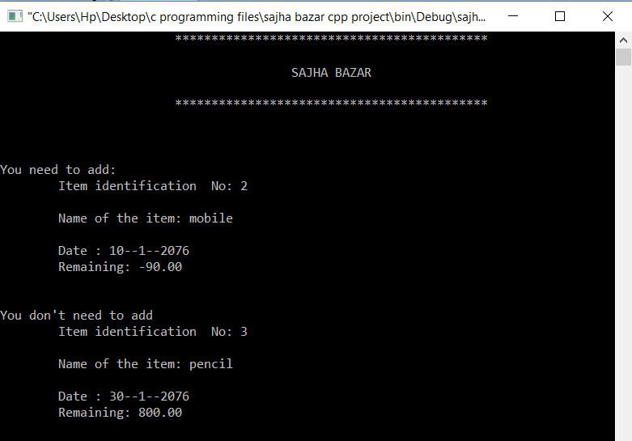
Survey
One can check whether number of product is less or more
Output
survey
Check Individual item
Less than 10%
Gives message to add
More than 10%
Suggest not to add

Slide 16
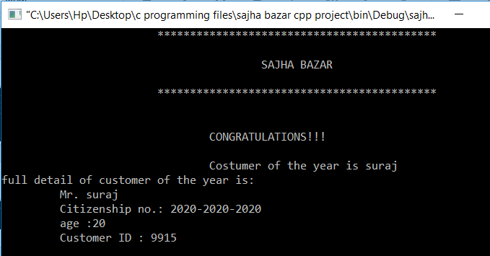
Gift hamper
Select the customer with costumer ID who has bought max worth of product
output

Slide 17
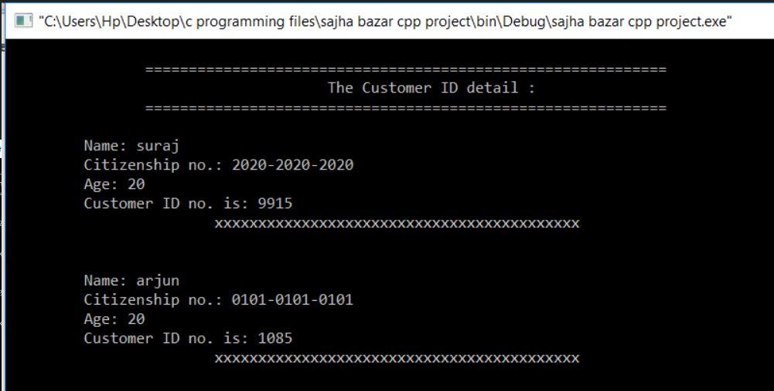
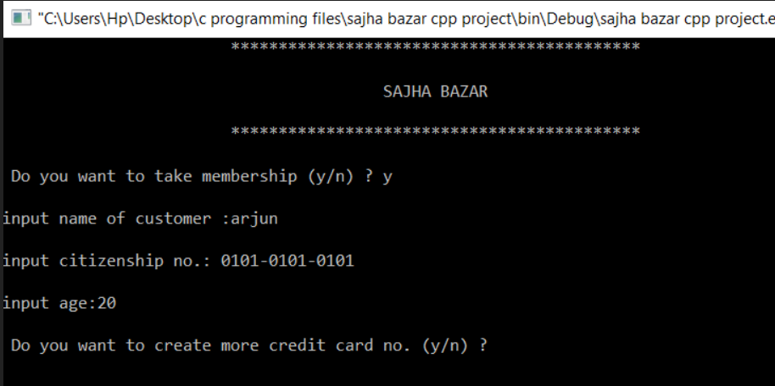
Customer ID
Can view or generate customer ID
Customer ID
Generate
View
view customer ID
Generate customer ID

Slide 18
User
User
Check customer ID
Suggestion
Buy
Automatic bill
customer
Buy product
With membership
Win gift and future discount
Without
Membership
No gift and future discount

Slide 19
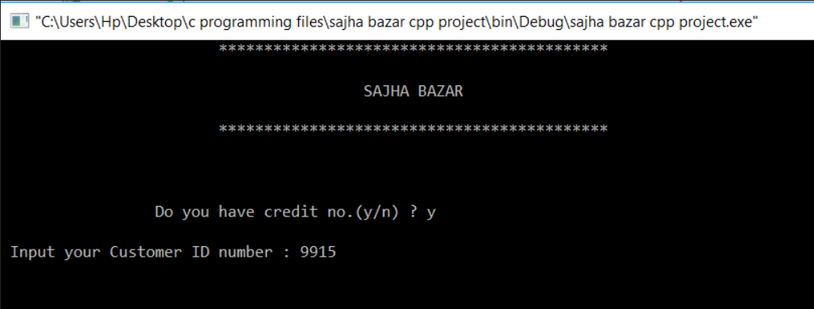
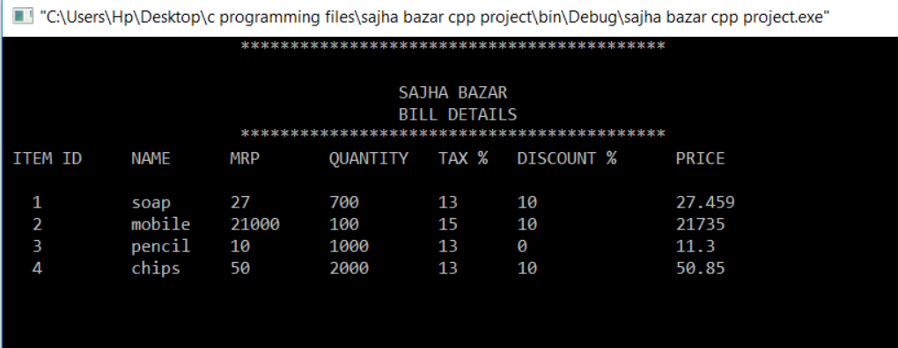
Check customer and suggest goods
check customer ID
Suggest goods

Slide 20
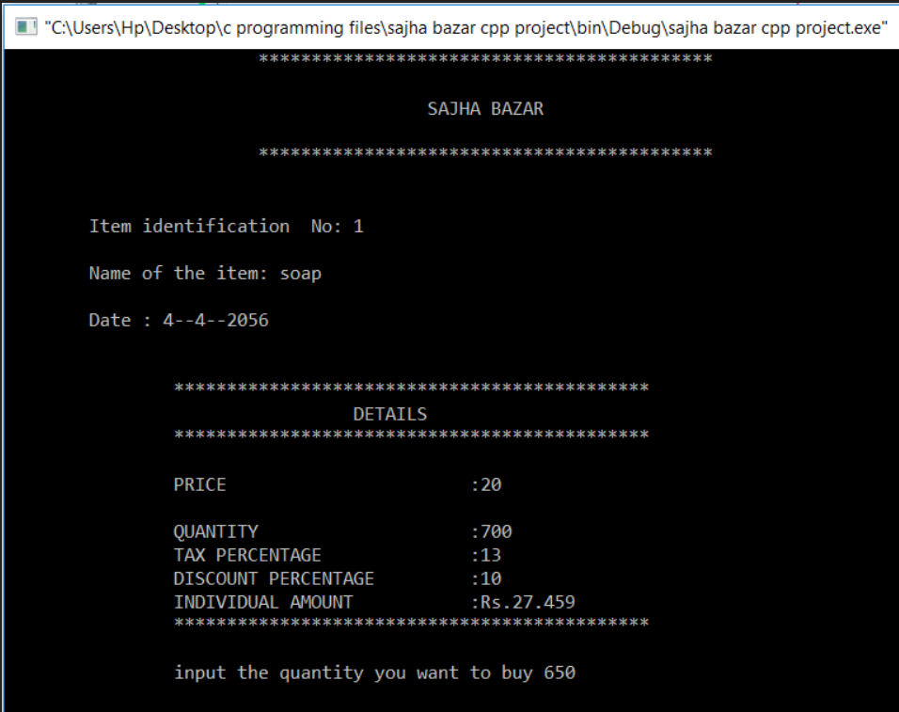
Buy
Consumer can buy goods

Slide 21
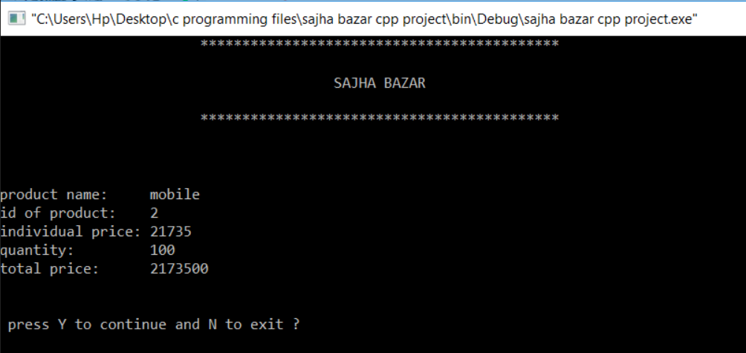
Automatic bill
Automatic bill
Without customer ID
With customer ID

Slide 22
CLASS 1
CLASS 2
protected Data member
protected Data member
Inherid class
Member
Function
Member
Function
project
amount
Friend class
CLASS 3
CLASS 4
protected Data member
protected Data member
Friend class
Member
Function
Member
Function
costumer
Fig: block diagram of classes
bill

Slide 23
Demo

Slide 24
Conclusion
Introduction of offline shopping system.
Processing will be faster.
Accuracy in bill generating.
Data will be secured.

Slide 25
Further works
Addition of graphics.
Introduction of unselect the selected item.
Selection of multiple goods at a time.
Introduction of user login system.
Adjust alert for less quantity according to seasons.
Test in applicable field.

Slide 26
Reference
E Balagurusamy, “Object Oriented Programming With C++”, fourth edition
Yashavant kanetkar , “ let us C” ,seventh edition
AI Kelly and Ira pohl, “ A Book on C”, fourth edition
http://www.wikipedia.org /wiki/literature review, 2019 jan 26
http://www.ioe.edu.np
Daya Sagar Baral, Duwakar Baral, Sharad Kumar Ghumire, “The Secrets of C Programming Language”

Slide 27
Thanks for your
precious
time

